Slide 1
Computation: C:\Users\babkevic\Documents\Projects\LiReF4\20170509 LiErF4 LET measurements analysis\Scripts\2017.05.31 MF-based on Bastien code\compare_LET_vs_RPA.m
Saved files: compare_LET_vs_RPA_sampleA.mat, etc

Slide 2
Computation: C:\Users\babkevic\Documents\Projects\LiReF4\20170509 LiErF4 LET measurements analysis\Scripts\2017.05.31 MF-based on Bastien code\compare_LET_vs_RPA.m
Saved files: compare_LET_vs_RPA_sampleA.mat, etc

Slide 3
Dom: 1
Dom: 2
Dom: 1+2
Computation: C:\Users\babkevic\Documents\Projects\LiReF4\20170509 LiErF4 LET measurements analysis\Scripts\2017.05.31 MF-based on Bastien code\run_sim_RPA_4D_v4.m
Saved files: -

Slide 4
Computation: C:\Users\babkevic\Documents\Projects\LiReF4\20170509 LiErF4 LET measurements analysis\Scripts\2017.05.31 MF-based on Bastien code\run_sim_RPA_4D_v4.m
Saved files: -

Slide 5
Measurement of LiErF₄ at H = Hc, T = 20 mK
======================================
Simulation parameters for LiEr(1)Ho(0)F4
T (K) = 0.02
Hx (T) = 0.00
Hy (T) = 0.00
Hz (T) = 0.55
J = 7.50
f = 0.23, I = 3.500, A (ueV) = 0.434, J_ex (ueV) = 0.000
Demagnetisation included: 1, Sample shape: 1
Renormalisation factor: 1.00, 1.00, 1.00
--------------------------------------------------------------
h = 0.00->1.10, dh = 0.02
k = -0.02->0.02, dk = -0.00
l = -0.02->0.02, dl = 0.00
w = -0.05->0.25, dw = 0.003000 meV
Damping = 0.0020000 meV
Domain population = 0.00-100.00
N(temp) = 1, N(field) = 1, N(Q) = 2800, N(E) = 101
Computation: C:\Users\babkevic\Documents\Projects\LiReF4\20170509 LiErF4 LET measurements analysis\Scripts\2017.05.31 MF-based on Bastien code\compare_LET_vs_RPA.m
Saved files: compare_LET_vs_RPA_sampleX.mat, compare_LET_vs_RPA_sampleY.mat

Slide 6
==Simulation parameters for LiEr(1)Ho(0)F4
T (K) = 0.02
Hx (T) = 0.00
Hy (T) = 0.00
Hz (T) = 0.55
J = 7.50
f = 0.23, I = 3.500, A (ueV) = 0.434, J_ex (ueV) = 0.000
Demagnetisation included: 1, Sample shape: 1
Renormalisation factor: 1.00, 1.00, 1.00
--------------------------------------------------------------
h = 0.00->1.10, dh = 0.02
k = -0.02->0.02, dk = 0.03
l = -0.02->0.02, dl = 0.00
w = -0.05->0.25, dw = 0.003000 meV
Damping = 0.0020000 meV
Domain population = 100.00-0.00
N(temp) = 1, N(field) = 1, N(Q) = 56, N(E) = 101
=ver=08.06.2017

Slide 7
Measurement of LiErF₄ at H = Hc, T = 20 mK
-> Intensity of the excitations is found to decrease much more rapidly experimentally than predicted by RPA
Comparing the measured dispersion and intensity, cannot explain the discrepancy as due to not being exactly at H = Hc.

Slide 8
dom = 1
dom = 2
Q=(0.97,0,0)
Q=(0.97,0,0)
Q=(0.96,0,0)
Q=(0.96,0,0)
Q=(0.98,0,0)
Q=(0.98,0,0)

Slide 9
Take cuts at (0,0,L) for different L values for 20 (left) and 500 (right) mK
Find that the shape of the elastic/incoherent scattering different below and above ordering temperature?
L = -0.85 seems to have the best compromise between weak Bragg peak and still be sufficiently close to the zone centre
Computation: C:\Users\babkevic\Documents\Projects\LiReF4\20170509 LiErF4 LET measurements analysis\Scripts\2017.05.31 MF-based on Bastien code\compare_LET_vs_RPA_tempdep.m
Saved files: -

Slide 10
Change in scattering
with (00L)
500 mK
22 mK
Numerically integrate (in E) only (0,0,-1) Intensity. Check if proton count taken into account – yes it is
No data between 370 and 500 mK
T (mK) | Run | uAmps
22 | 2684 | 36
100 | 2769 | 27
200 | 2762 | 27
260 | 2755 | 27
330 | 2745 | 30
350 | 2734 | 30
360 | 2723 | 30
365 | 2712 | 30
370 | 2701 | 27
500 | 2776 | 30
Fit 22 mK and 500 mK data with a voigtxN_detailedbalance function:
Lorentzian width (fix Gaussian to be same) changes from
2.5871e-07 meV at 22 mK to 0.0069142 meV at 500 mK

Slide 11
1-dimensional object:
-------------------------
Original datafile: Z:\ISIS\LET_LiErF4\LET_Oct\SQW\LET2776_1.50meV_Rings.sqw
Title: <none>
Lattice parameters (Angstroms and degrees):
a=5.175 b=5.175 c=10.75
alpha=90 beta=90 gamma=90
Size of 1-dimensional dataset: [76]
Plot axes:
E = -0.051:0.002:0.101
Integration axes:
-0.075 =< h =< 0.075 in [h, 0, 0]
-0.075 =< k =< 0.075 in [0, k, 0]
-0.925 =< l =< -0.775 in [0, 0, l]
Computation: C:\Users\babkevic\Documents\Projects\LiReF4\20170509 LiErF4 LET measurements analysis\Scripts\2017.05.31 MF-based on Bastien code\compare_LET_vs_RPA_tempdep.m
Saved files: -

Slide 12
Careful! Need to include Q-dep as a function of E in these cuts!
Simulation parameters for LiEr(1)Ho(0)F4
T (K) = 0.00-1.50, dT = 0.04
Hx (T) = 0.00
Hy (T) = 0.00
Hz (T) = 0.00
J = 7.50
f = 0.23, I = 3.500, A (ueV) = 0.434, J_ex (ueV) = 0.000
Demagnetisation included: 1, Sample shape: 1
Renormalisation factor: 1.00, 1.00, 1.00
--------------------------------------------------------------
h = 0.00
k = 0.00
l = 0.85
w = -0.05->0.10, dw = 0.001500 meV
Damping = 0.0020000 meV
Domain population = 0.00-100.00
N(temp) = 41, N(field) = 1, N(Q) = 1, N(E) = 101
=ver=08.06.2017=========================
T = 22 mK
(0,0,0.85)
T = 22 mK
(0,0,1)
The HF coupling strength has little effect on the size of the gap.
Computation: C:\Users\babkevic\Documents\Projects\LiReF4\20170509 LiErF4 LET measurements analysis\Scripts\2017.05.31 MF-based on Bastien code\compare_LET_vs_RPA_tempdep.m
Saved files: -

Slide 13



Hyp(Er) = 23%
Hyp(Er) = 0%
Hyp(Er) = 100%
$$χ_{zz}"$$
$$χ_{zz}"$$
$$χ_{zz}"$$
Energy (meV)
(0,0,H)
(0,0,H)
(0,0,H)
Energy of mode
Energy (meV)
<Jx>
(0,0,H)

Slide 14
Field dependence of excitation around (100)
Integration axes:
0.96 =< h =< 0.98 in [h, 0, 0]
-0.05 =< k =< 0.05 in [0, k, 0]
-0.05 =< l =< 0.09 in [0, 0, l]
Computation: C:\Users\babkevic\Documents\Projects\LiReF4\20170509 LiErF4 LET measurements analysis\Scripts\2017.05.31 MF-based on Bastien code\compare_LET_vs_RPA_fielddep.m
Saved files: -

Slide 15
Field dependence of excitation around (100)
Dom: 1
Dom: 2
100% nuc HF Er
50-50 domain population

Slide 16
Change in the spectrum through thermal and quantum phase transitions
Dom 2 only
Dom 1 only
In these calculations, 50 points randomly q-points were picked from the h, k, l bin limits. The spectrum is an average over the 50 points at each T, H step
Energy (meV)
Energy (meV)
T/T_{N}
H/H_{c}
Dom 2 only
Dom 1 only
Calculation taking into account the change in the Q-vector as a function of E
Calculated: /home/awu49520/LET_LiErF4/MF-RPA_v5/compare_LET_vs_RPA_tempdep.m, data stored in Fielddep.mat and Tempdep.mat
Calculated: /home/awu49520/LET_LiErF4/MF-RPA_v5/compare_LET_vs_RPA_tempdep.m,
C:\Users\babkevic\Documents\Projects\LiReF4\20170509 LiErF4 LET measurements analysis\Scripts\2017.05.31 MF-based on Bastien code\compare_LET_vs_RPA_fielddep.m
data stored in Fielddep2.mat and Tempdep2.mat

Slide 17
Hyperfine interaction effect on the QPT
Simulation parameters for LiEr(1)Ho(0)F4
T (K) = 0.00
Hx (T) = 0.00-0.00, dHx = 0.00
Hy (T) = 0.00-0.00, dHx = 0.00
Hz (T) = 0.00-0.65, dHx = 0.02
J = 7.50
f = 1.00, I = 3.500, A (ueV) = 0.434, J_ex (ueV) = 0.000
Demagnetisation included: 1, Sample shape: 1
Renormalisation factor: 1.00, 1.00, 1.00
--------------------------------------------------------------
h = 1.00
k = 0.00
l = 0.00
w = 0.00->0.05, dw = 0.001000 meV
Damping = 0.0020000 meV
Domain population = 100.00-0.00
N(temp) = 1, N(field) = 31, N(Q) = 1, N(E) = 101
Assume 100% Hyp Er, vary coupling
T(MF) = 0.00 K
23% Hyp,
A = 0.434 ueV
100% Hyp
0.23*A = 0.1 ueV
Softening of energy gap of the lowest observed mode only occurs for very weak hyperfine coupling
The effect of diluting Hyp Er ions is the same as reducing strength of HF coupling but keeping the population the same
(legend units neV, no ueV)
C:\Users\babkevic\Documents\Projects\LiReF4\20170509 LiErF4 LET measurements analysis\Scripts\2017.05.31 MF-based on Bastien code\compare_LET_vs_RPA_fielddep.m

Slide 18
Hyperfine interaction effect on the QPT
23% Hyp Er
T(MF) = 0.25 K
T(MF) = 0.10 K
T(MF) = 0.02 K
100% Hyp Er
100% Hyp Er
23% Hyp Er

Slide 19
T(MF) = 0.0 K
T(MF) = 0.1 K
T(MF) = 0.2 K
T(MF) =
0.0 K
0.1 K
0.2 K

Slide 20
Why is there an upturn in excitation energy close to Hc in the v5 simulation but not in v1?
v1 RPA simulation
v5 RPA simulation
(100)
(100)
Root cause: chi_qw_VC - the way chi(r,s) are mixed. Setting sample.nohyp_hyp -> makes chi0(no HF) = chi0(HF) reproduces v1 RPA simulations

Slide 22
Calculations of the entanglement entropy between e and n
Hyperfine Er population:
1%
25%
50%
75%
100%
Hyperfine Er population:
1%
25%
50%
75%
100%
T = 22 mK
T = 0 mK
Entanglement entropy
QPT
QPT
(0,0,H) T
(0,0,H) T
C:\Users\babkevic\Documents\Projects\LiReF4\20170509 LiErF4 LET measurements analysis\Scripts\2017.05.31 MF-based on Bastien code\calc_entanglement_entropy.m

Slide 23
T=0, H=0
T=0.9TN, H=0
T=0, H=0
T=0, H=0.9Hc
(0,k,-0.5)
(0,k,-0.5)
T=0.3TN, H=0
T=0, H=0.3Hc
T=0, H=1.2Hc
T (K) = 0.00
Hx (T) = 0.00
Hy (T) = 0.00
Hz (T) = 0.00
J = 7.50
f = 0.23, I = 3.500, A (ueV) = 0.434, J_ex (ueV) = 0.000
Demagnetisation included: 1, Sample shape: 1
Renormalisation factor: 1.00, 1.00, 1.00
--------------------------------------------------------------
h = 0.00
k = -0.50->0.50, dk = 0.05
l = -0.50
w = 0.04->0.07, dw = 0.000175 meV
Damping = 0.0020000 meV
Domain population = 0.00-100.00
N(temp) = 1, N(field) = 1, N(Q) = 21, N(E) = 201
T=0.6TN, H=0
T=0, H=0.6Hc
C:\Users\babkevic\Documents\Projects\LiReF4\20170509 LiErF4 LET measurements analysis\Scripts\2017.05.31 MF-based on Bastien code\calc_FlatMode.m

Slide 24
Simulation parameters for LiEr(1)Ho(0)F4
T (K) = 0.00
Hx (T) = 0.00
Hy (T) = 0.00
Hz (T) = 0.00
J = 7.50
f = 0.23, I = 3.500, A (ueV) = 0.434, J_ex (ueV) = 0.000
Demagnetisation included: 1, Sample shape: 1
Renormalisation factor: 1.00, 1.00, 1.00
--------------------------------------------------------------
h = 0.00
k = -0.50->0.50, dk = 0.05
l = -0.50
w = -0.05->0.25, dw = 0.001500 meV
Damping = 0.0020000 meV
Domain population = 0.00-100.00
N(temp) = 1, N(field) = 1, N(Q) = 21, N(E) = 201
=ver=29.10.2018================================
(0,k,0.5)
(h,0,0.5)
(h,0.5,0.5)
(0,0,l)
(0,0.5,l)

Slide 25
T (K) = 0.00
Hx (T) = 0.00
Hy (T) = 0.00
Hz (T) = 0.00
J = 7.50
f = 0.23, I = 3.500, A (ueV) = 0.434, J_ex (ueV) = 0.000
Demagnetisation included: 1, Sample shape: 1
Renormalisation factor: 1.00, 1.00, 1.00
--------------------------------------------------------------
h = 0.00
k = -0.50->0.50, dk = 0.05
l = -0.50
w = 0.04->0.07, dw = 0.000175 meV
Damping = 0.0020000 meV
Domain population = 0.00-100.00
N(temp) = 1, N(field) = 1, N(Q) = 21, N(E) = 201
0.55 ueV
On the order of A?
E (meV)
Simulation parameters for LiEr(1)Ho(0)F4
T (K) = 0.00
Hx (T) = 0.00
Hy (T) = 0.00
Hz (T) = 0.00
J = 7.50
f = 0.23, I = 3.500, A (ueV) = 0.000, J_ex (ueV) = 0.000
Demagnetisation included: 1, Sample shape: 1
Renormalisation factor: 1.00, 1.00, 1.00
--------------------------------------------------------------
h = 0.00
k = -0.50->0.50, dk = 0.05
l = -0.50
w = 0.04->0.07, dw = 0.000175 meV
Damping = 0.0020000 meV
Domain population = 0.00-100.00
N(temp) = 1, N(field) = 1, N(Q) = 21, N(E) = 201
=ver=29.10.2018====================================
E (meV)

Slide 26
Addition of a h4 anisotropy to account for order by disorder effect
h₄ = 0
h₄ = -3.5
(0,0,0.85)
(0.97,0,0)

Slide 27
Computation: /home/awu49520/LET_LiErF4/MF-RPA_v6/compare_LET_vs_RPA_v2.m
Saved files: compare_LET_vs_RPA_sampleA.mat, etc

Slide 28
Computation: /home/awu49520/LET_LiErF4/MF-RPA_v6/compare_LET_vs_RPA_v2.m
Saved files: compare_LET_vs_RPA_sampleA.mat, etc

Slide 29
th: rotation of every other spin
3/4
Calculate the classical energy sum of the spin configuration and how it is affected by lattice distortion, rotation of every other spin and with an applied transverse field
1/4
1/2
1/4
z = 0
3/4
Simulation: C:\Users\babkevic\Documents\Projects\LiReF4\20170509 LiErF4 LET measurements analysis\Scripts\2017.05.31 MF-based on Bastien code\lattice_distort.m

Slide 30
No h4 anisotropy
H = Hc
Including resolution broadening

Slide 31
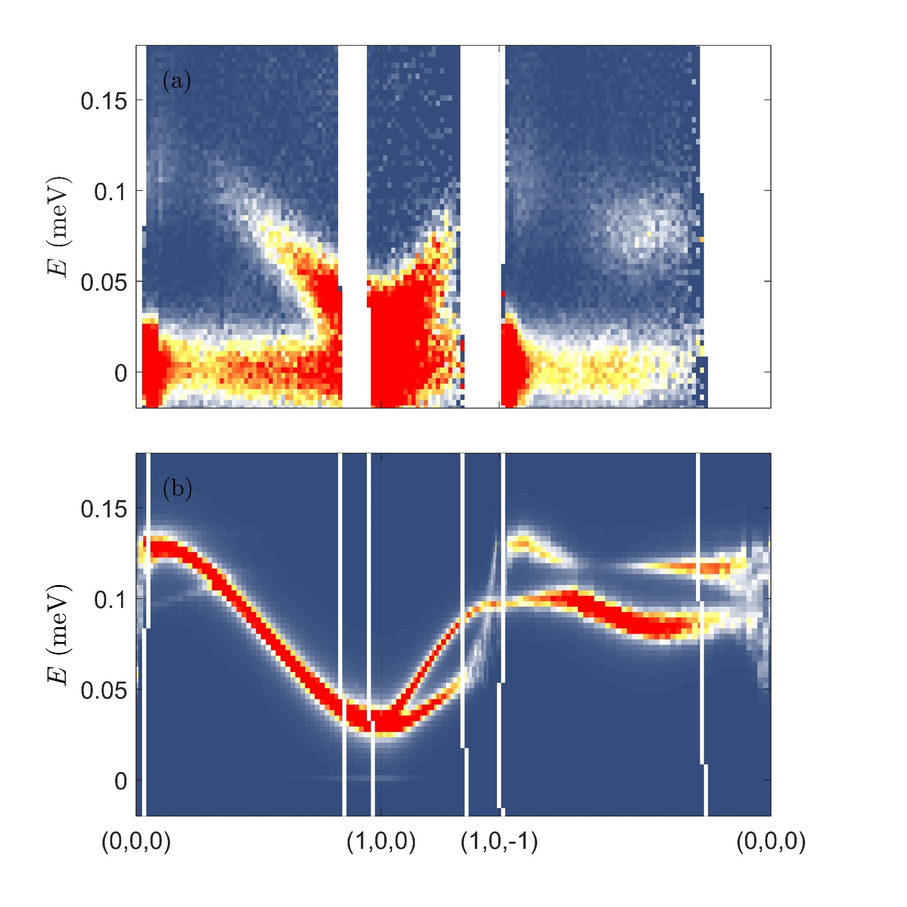
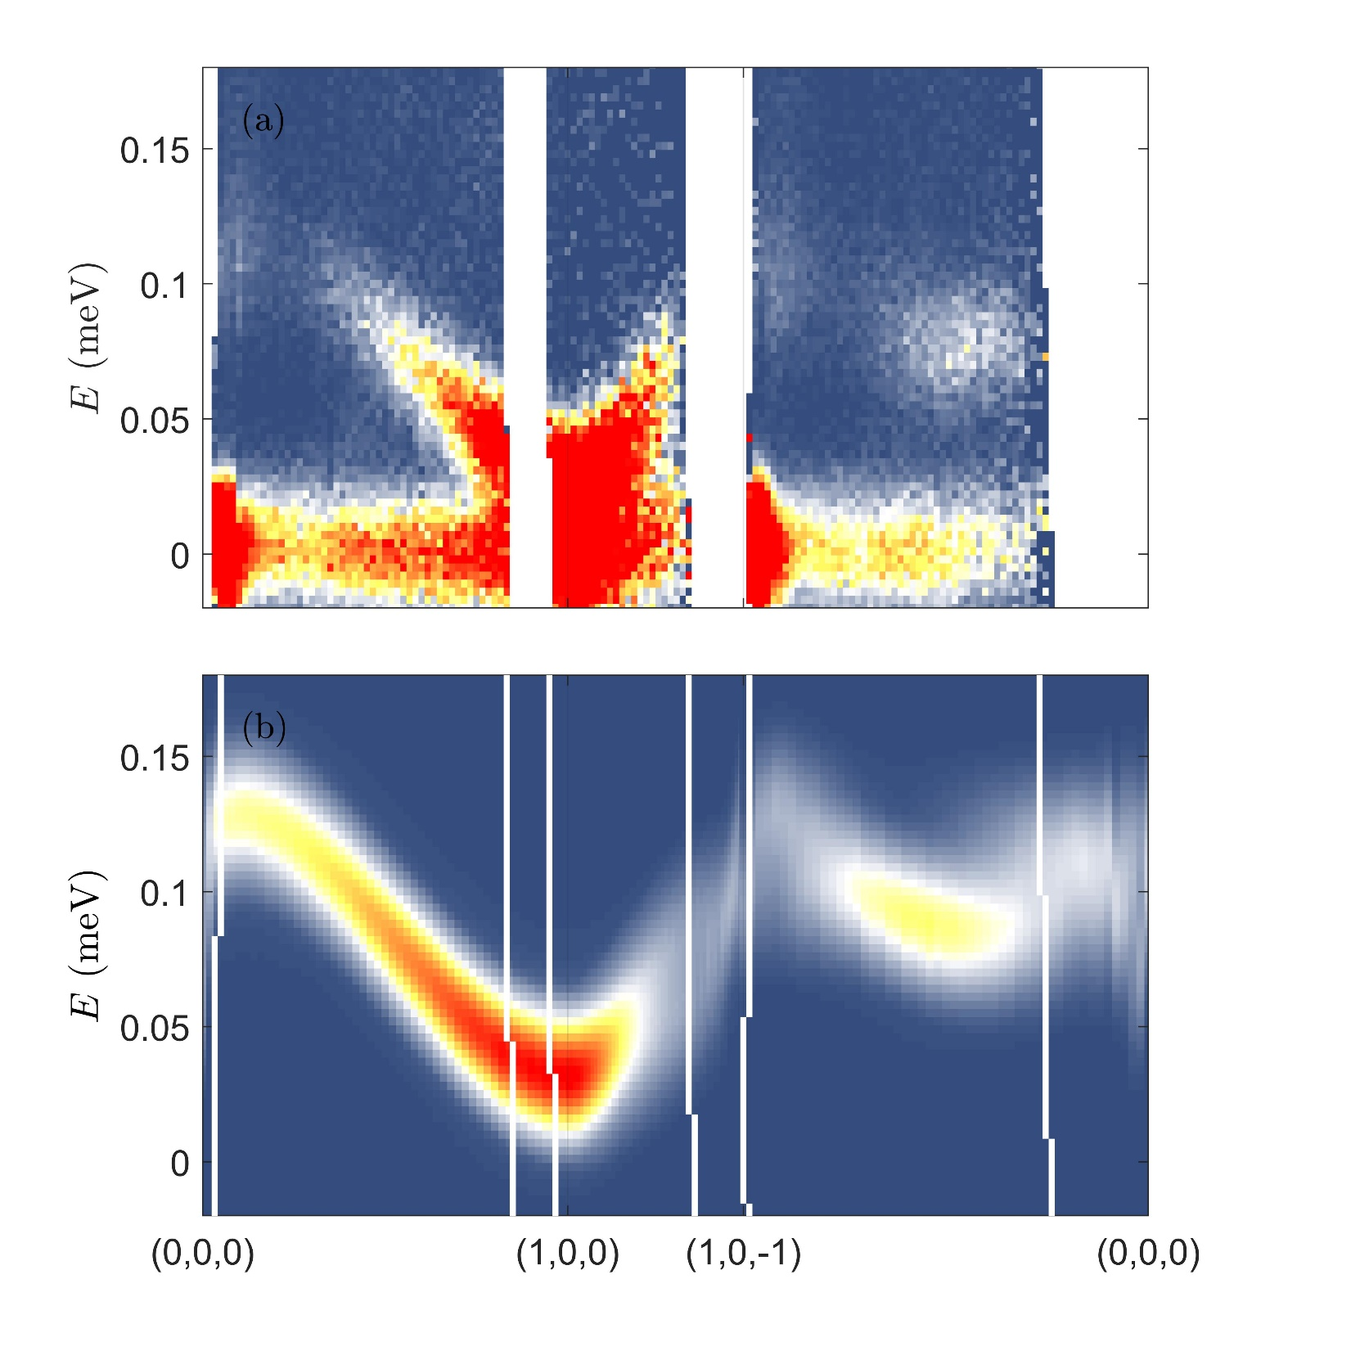
Inc h4 anisotropy
H = Hc
Including resolution broadening

Slide 32
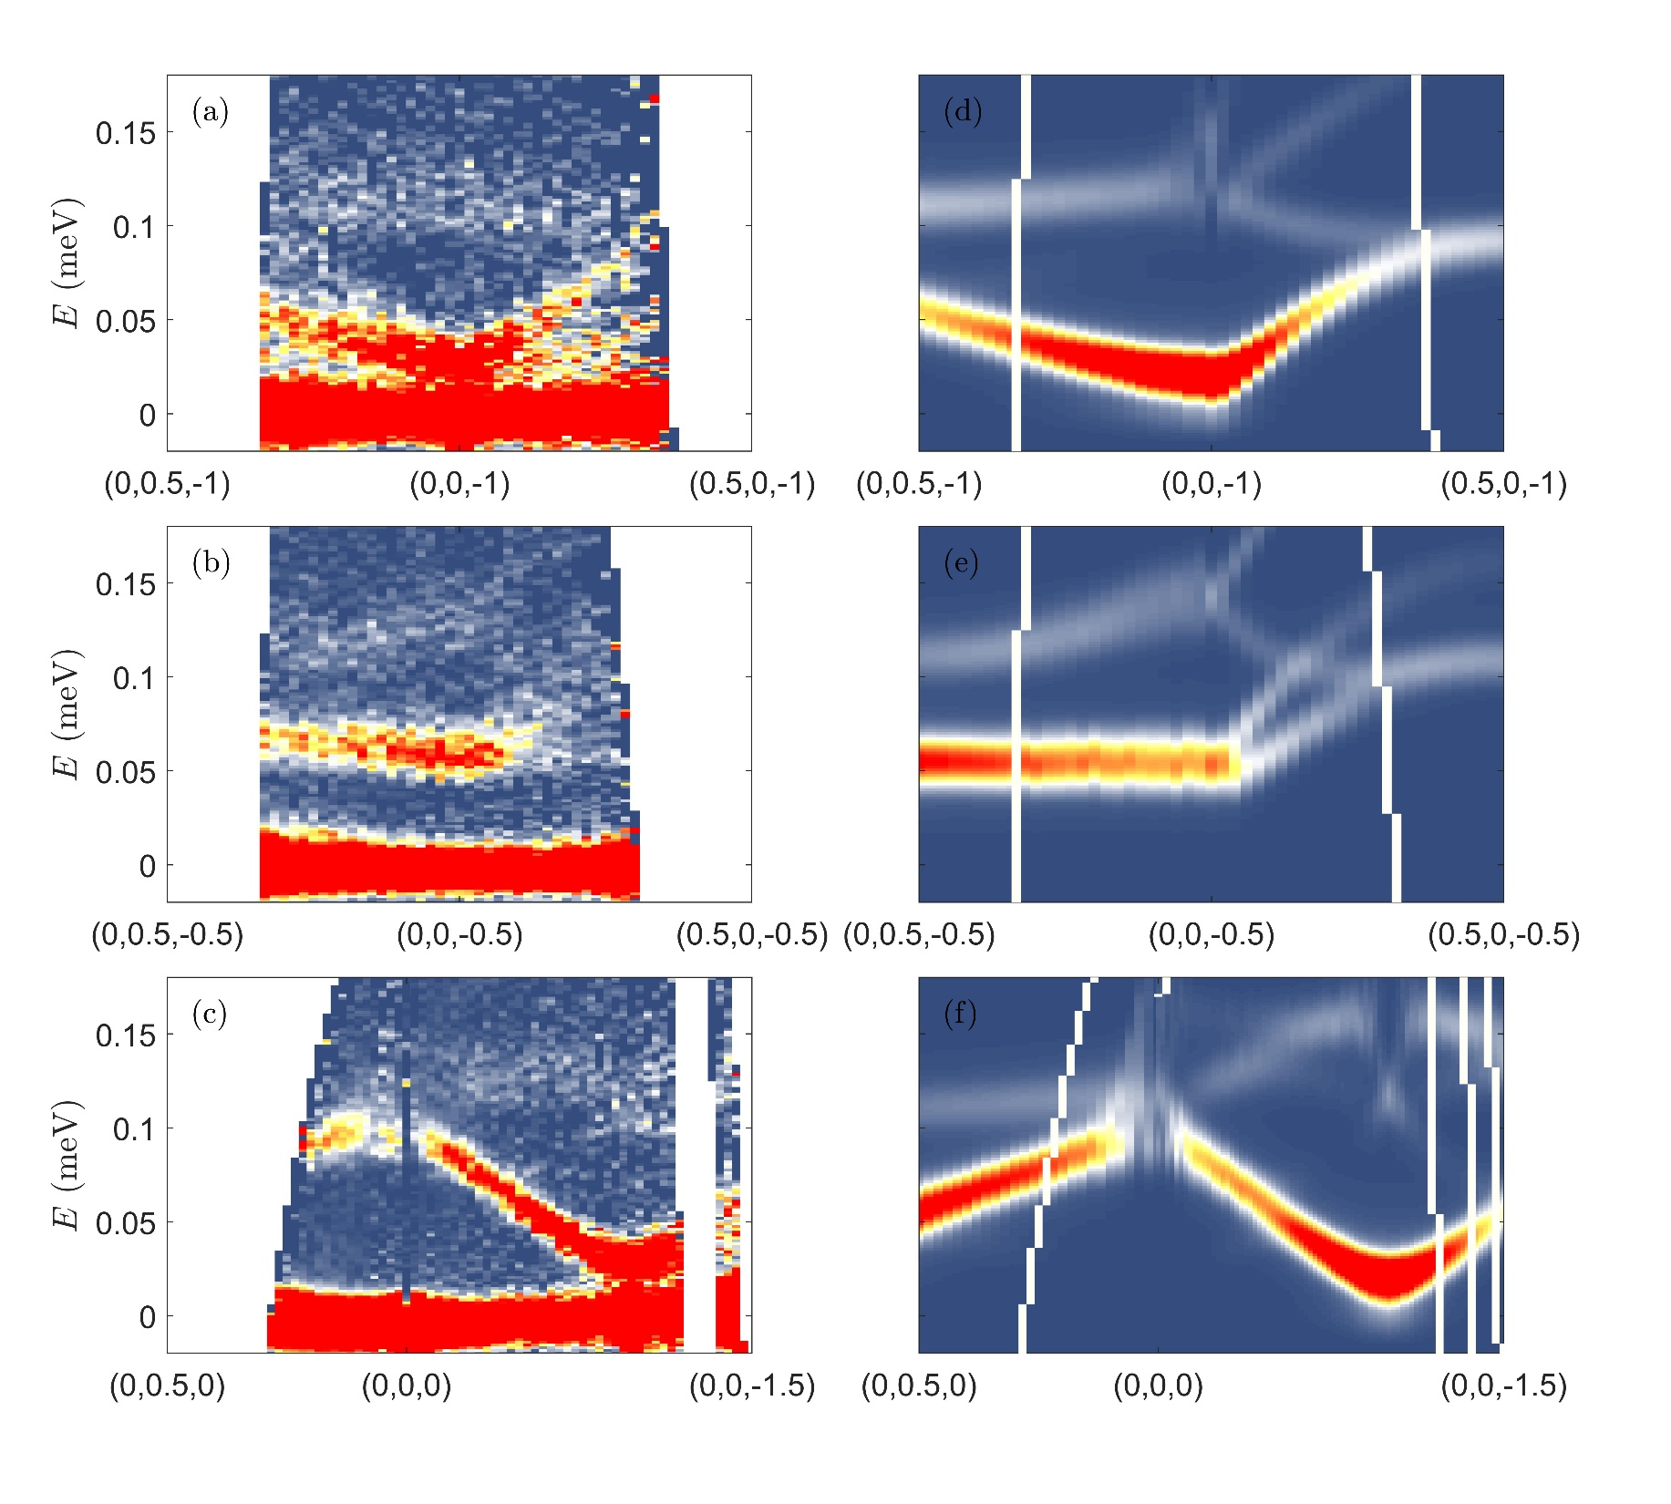
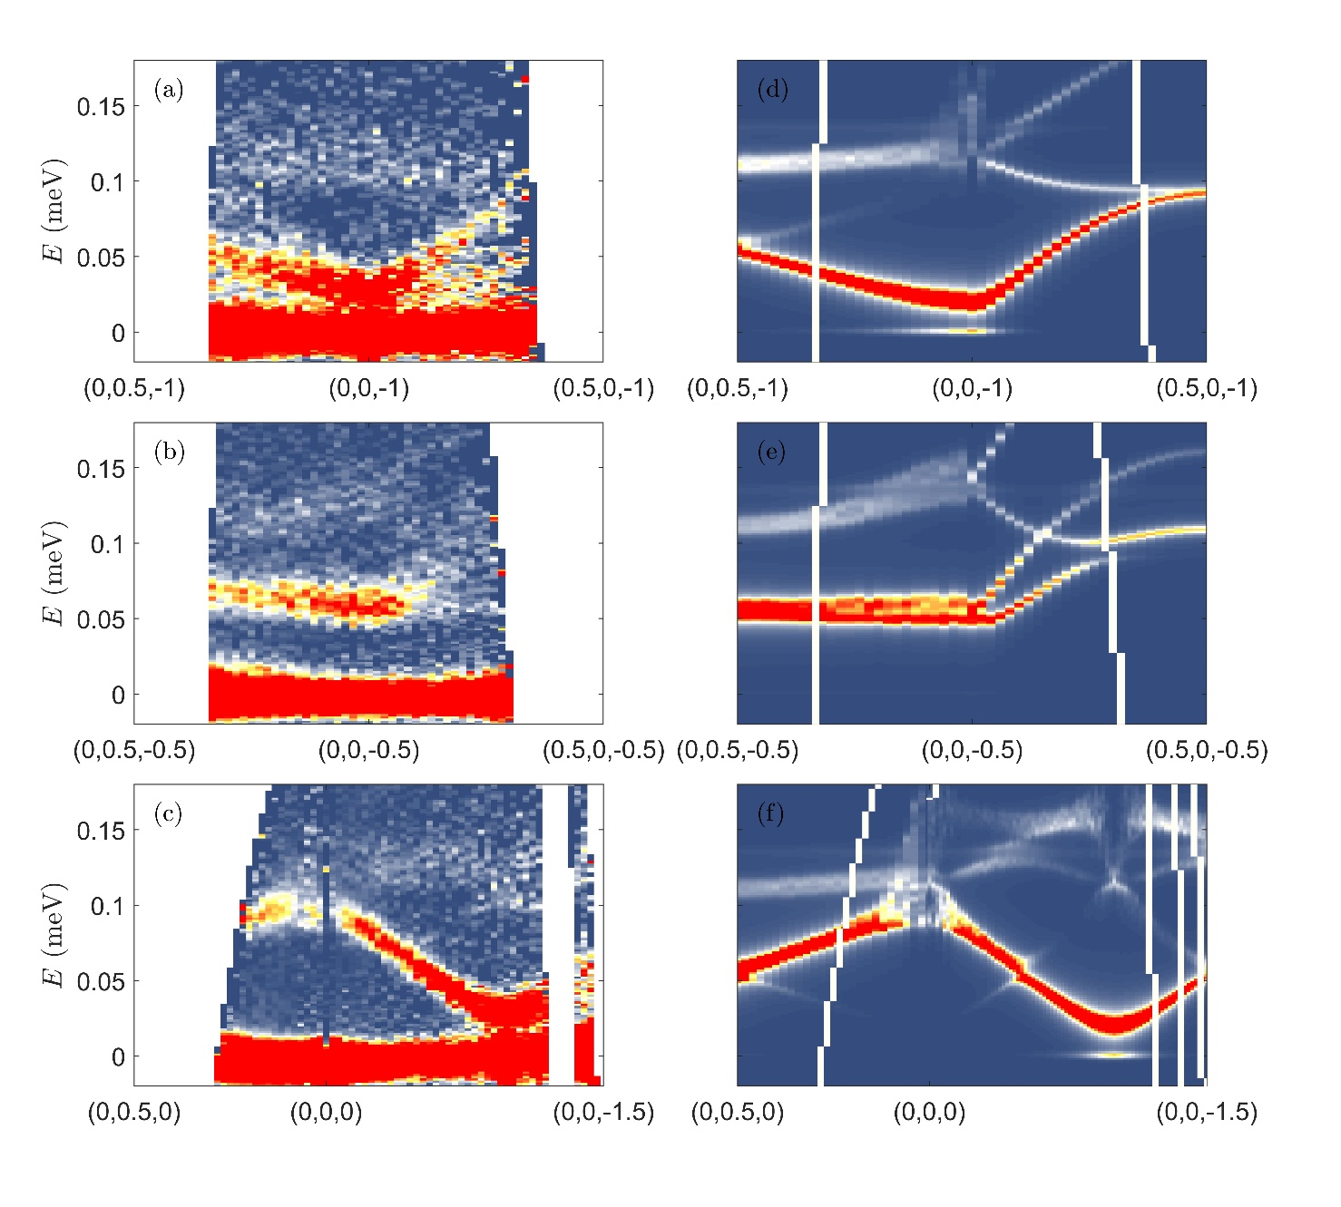
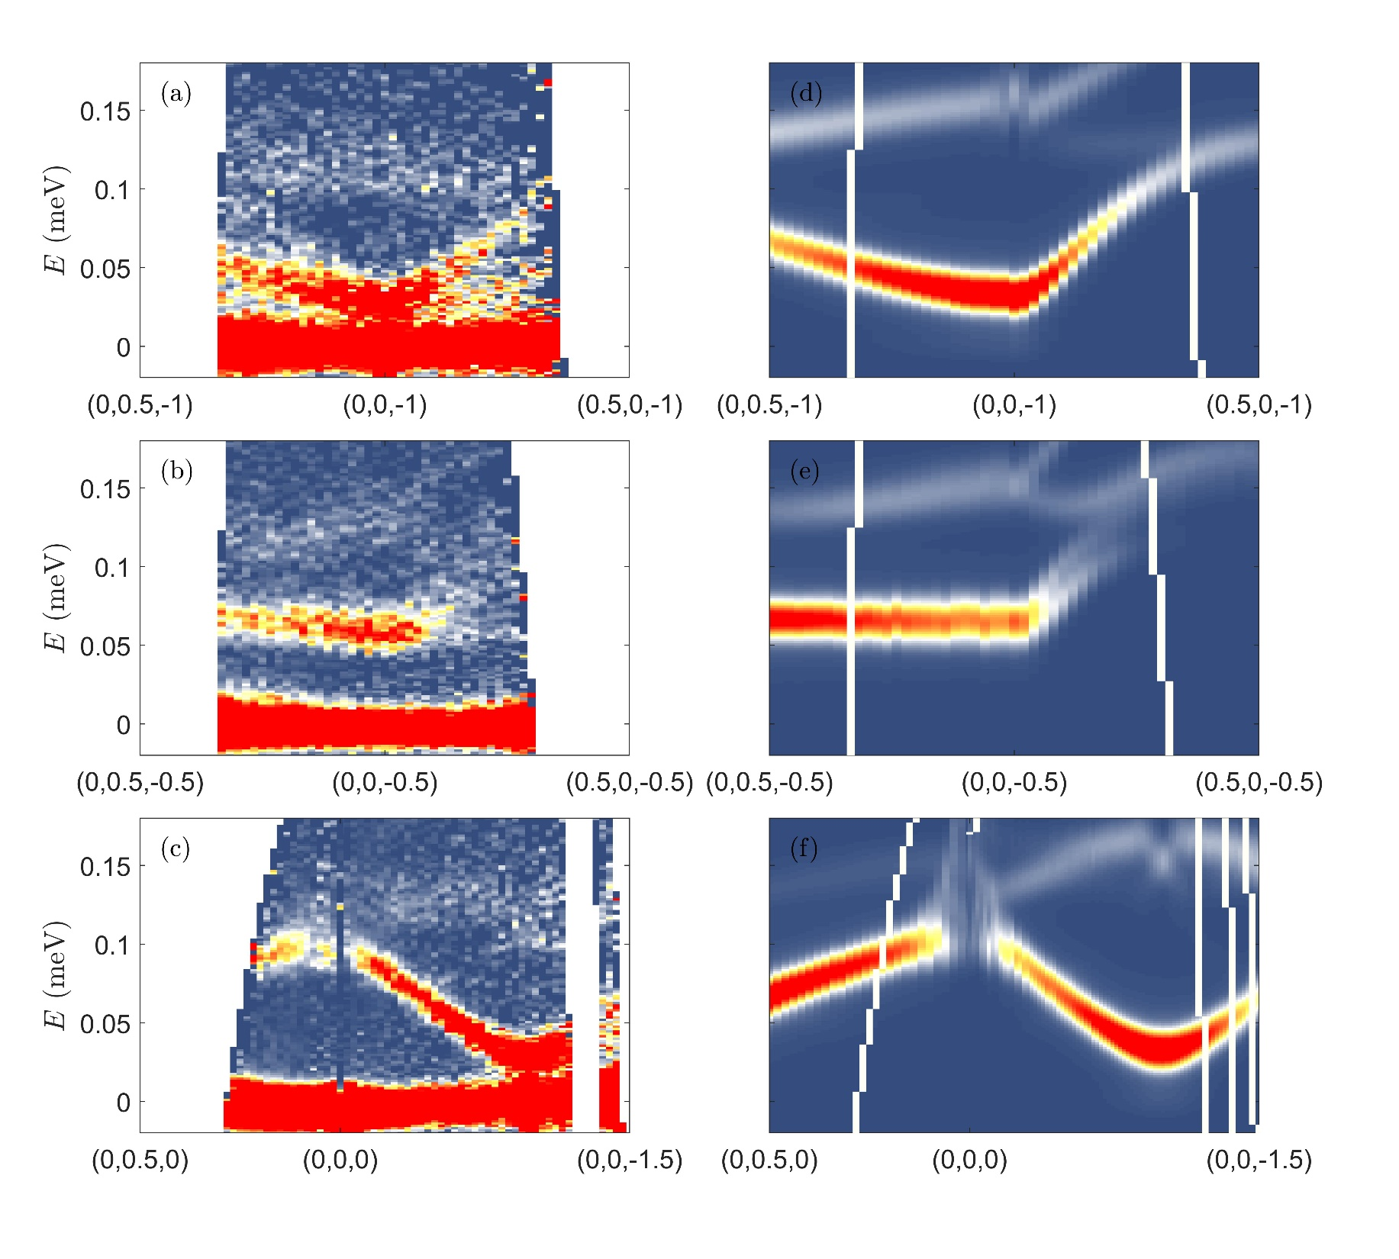
No h4 anisotropy
No h4 anisotropy
Inc h4 anisotropy

Slide 33

Green: extracted line from simulations with h4=0
Magenta: h4 included in the calculations
Both simulations made for T = 0.02 K in the MF-RPA

Slide 34
Can we estimate the sample temperature from detailed balance?
T = 0.05 K
T = 0.1 K
T = 0.2 K

Slide 35
Slice through the elastic channel to observe any diffuse scattering

